Slide 1
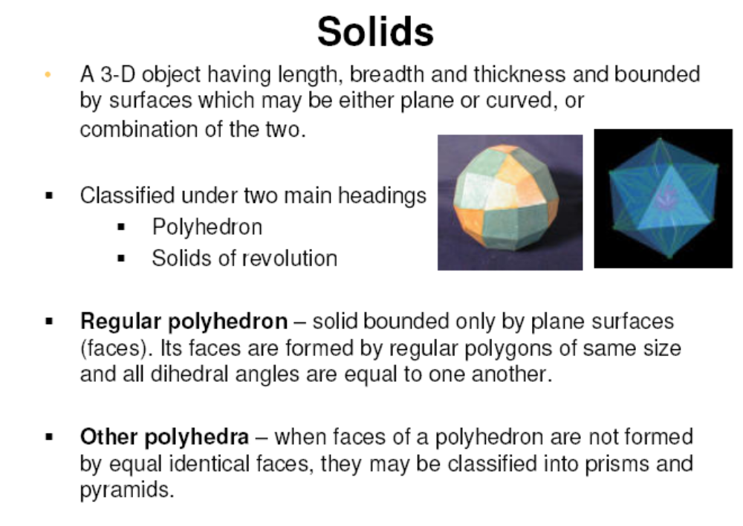

Slide 2
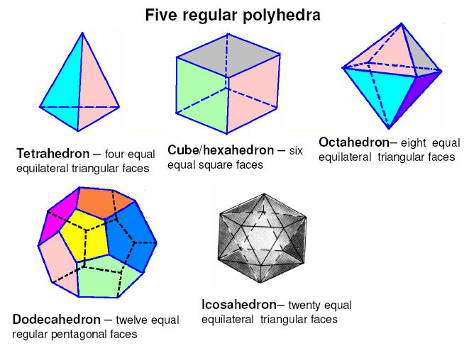

Slide 3
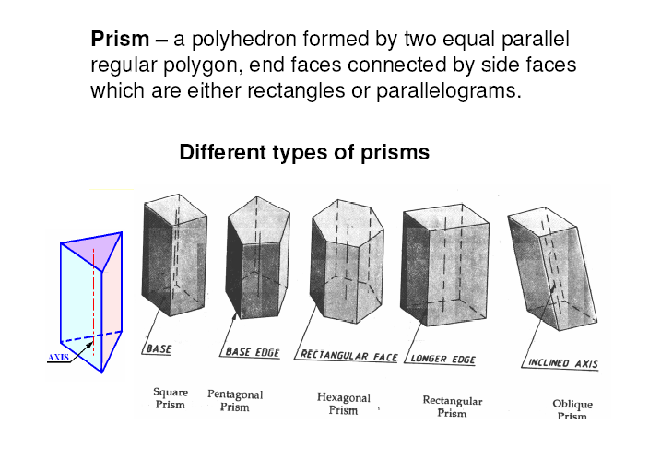

Slide 4
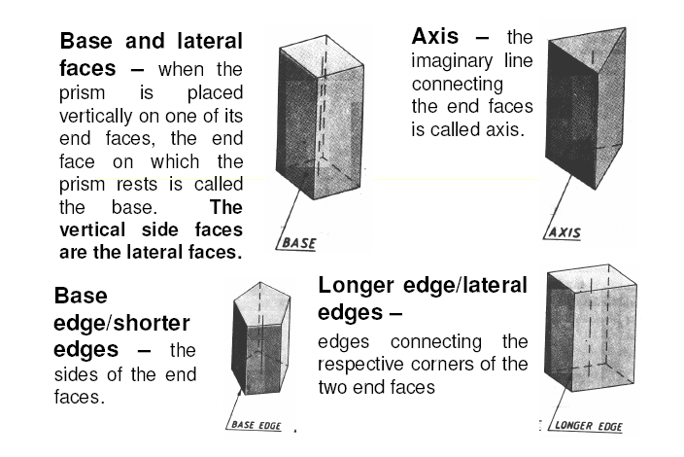

Slide 5
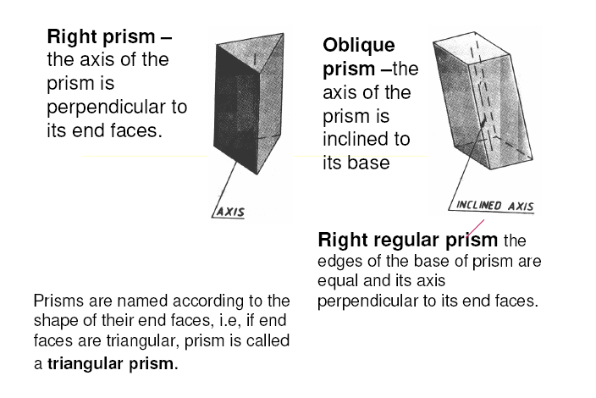

Slide 6
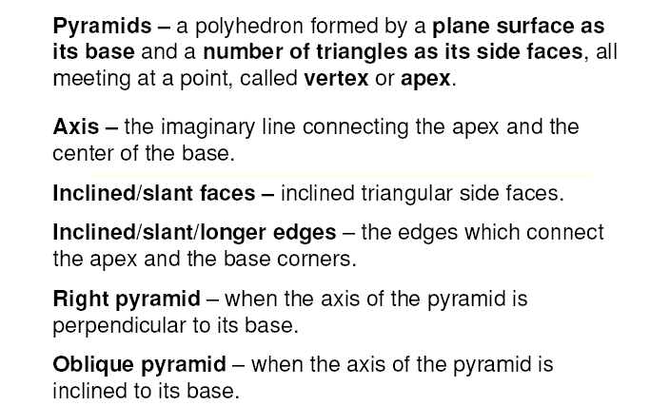

Slide 7
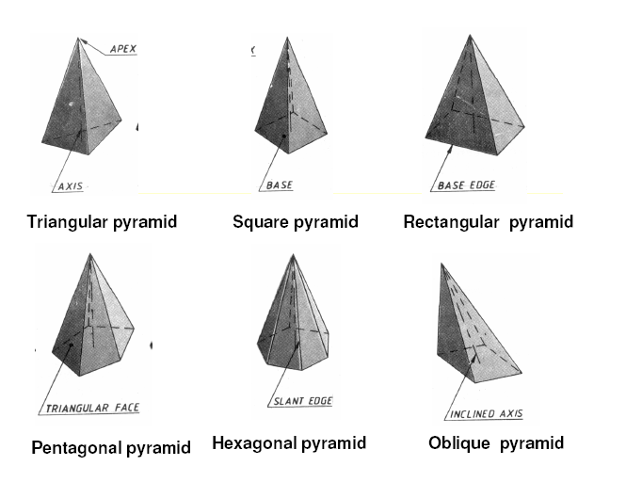

Slide 8
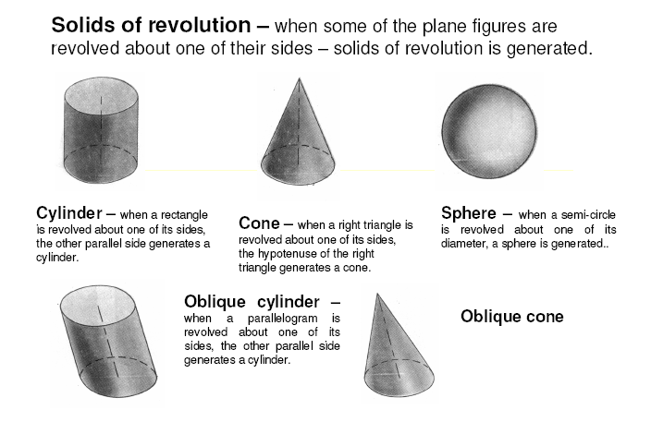

Slide 9
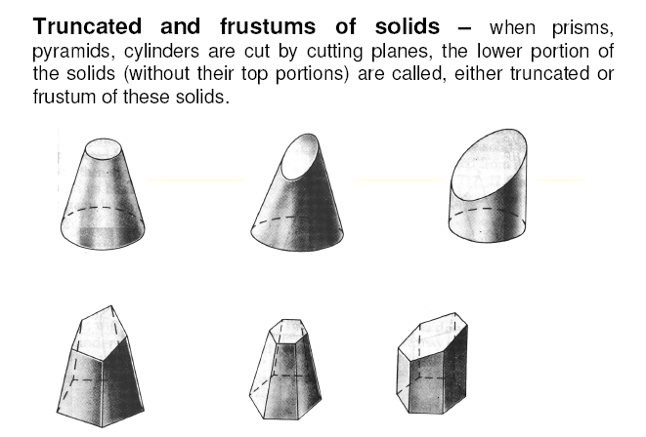

Slide 10
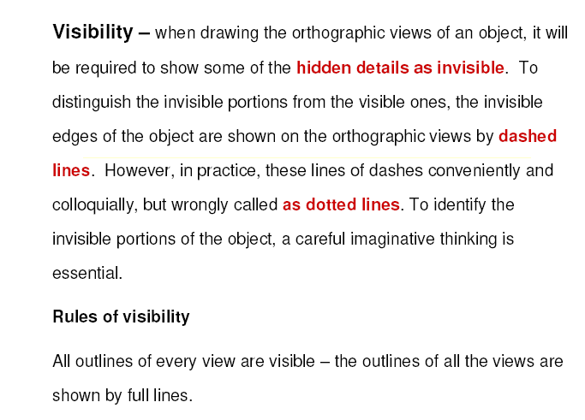

Slide 11
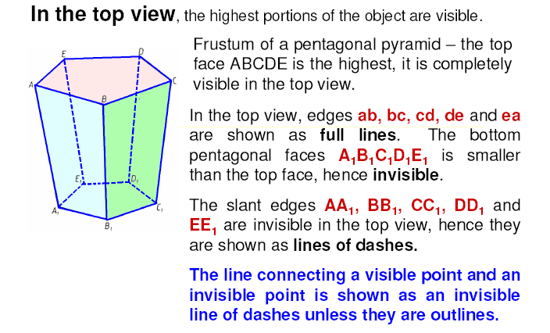

Slide 12
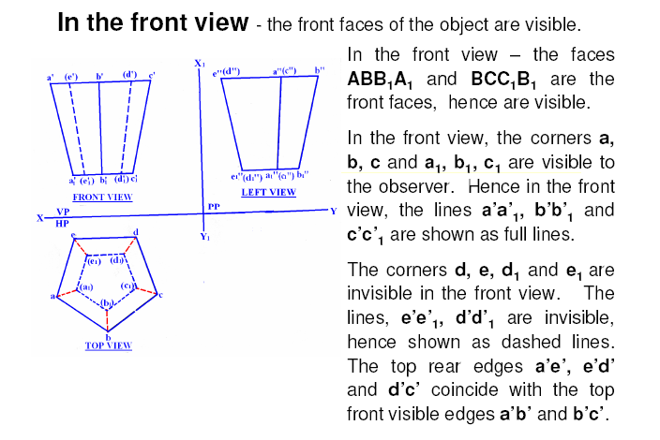

Slide 13
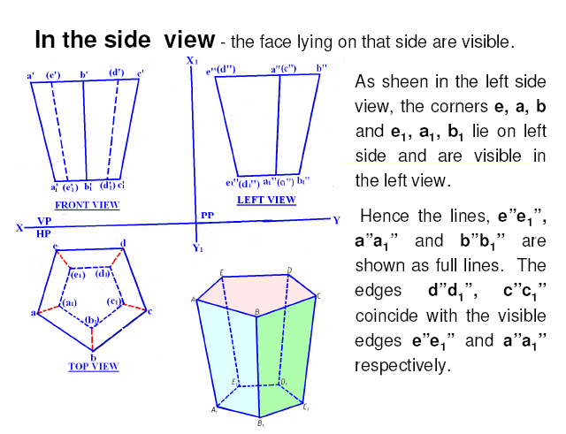

Slide 14
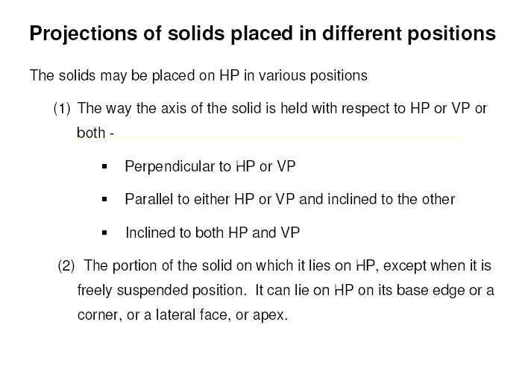

Slide 15
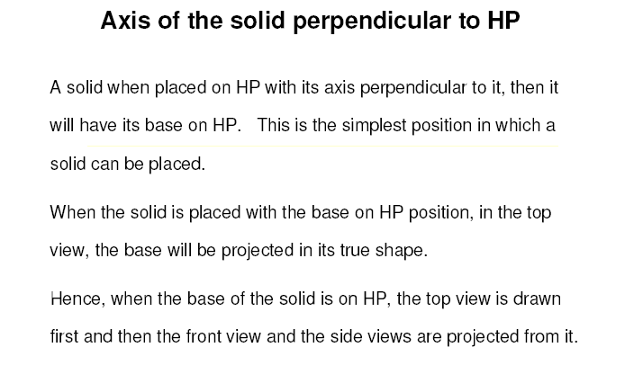

Slide 16
STANDING ON H.P
On it’s base.
RESTING ON H.P
On one point of base circle.
LYING ON H.P
On one generator.
(Axis perpendicular to Hp
And // to Vp.)
(Axis inclined to Hp
And // to Vp)
(Axis inclined to Hp
And // to Vp)
F.V.
F.V.
F.V.
X
Y
While observing Fv, x-y line represents Horizontal Plane. (Hp)
X
While observing Tv, x-y line represents Vertical Plane. (Vp)
Y
T.V.
T.V.
T.V.
STANDING ON V.P
On it’s base.
RESTING ON V.P
On one point of base circle.
LYING ON V.P
On one generator.
Axis perpendicular to Vp
And // to Hp
Axis inclined to Vp
And // to Hp
Axis inclined to Vp
And // to Hp

Slide 17
STEPS TO SOLVE PROBLEMS IN SOLIDS
Problem is solved in three steps:
STEP 1: ASSUME SOLID STANDING ON THE PLANE WITH WHICH IT IS MAKING INCLINATION.
( IF IT IS INCLINED TO HP, ASSUME IT STANDING ON HP)
( IF IT IS INCLINED TO VP, ASSUME IT STANDING ON VP)
IF STANDING ON HP - IT’S TV WILL BE TRUE SHAPE OF IT’S BASE OR TOP:
IF STANDING ON VP - IT’S FV WILL BE TRUE SHAPE OF IT’S BASE OR TOP.
BEGIN WITH THIS VIEW:
IT’S OTHER VIEW WILL BE A RECTANGLE ( IF SOLID IS CYLINDER OR ONE OF THE PRISMS):
IT’S OTHER VIEW WILL BE A TRIANGLE ( IF SOLID IS CONE OR ONE OF THE PYRAMIDS):
DRAW FV & TV OF THAT SOLID IN STANDING POSITION:
STEP 2: CONSIDERING SOLID’S INCLINATION ( AXIS POSITION ) DRAW IT’S FV & TV.
STEP 3: IN LAST STEP, CONSIDERING REMAINING INCLINATION, DRAW IT’S FINAL FV & TV.
GENERAL PATTERN ( THREE STEPS ) OF SOLUTION:
GROUP B SOLID.
CONE
GROUP A SOLID.
CYLINDER
GROUP B SOLID.
CONE
GROUP A SOLID.
CYLINDER
AXIS
INCLINED HP
AXIS
INCLINED HP
AXIS
VERTICAL
AXIS
INCLINED HP
AXIS
VERTICAL
AXIS
INCLINED HP
AXIS
INCLINED VP
er
AXIS
INCLINED
VP
er
AXIS
INCLINED
VP
AXIS
INCLINED VP
AXIS TO VP
AXIS TO VP
Three steps
If solid is inclined to Hp
Three steps
If solid is inclined to Hp
Three steps
If solid is inclined to Vp
Three steps
If solid is inclined to Vp

Slide 18
Problem 1. A square pyramid, 40 mm base sides and axis 60 mm long, has a triangular face on the ground. The vertical plane containing the axis makes an angle of 45⁰ with the VP. Draw its projections. Take apex nearer to VP
Solution Steps :
Triangular face on Hp , means it is lying on Hp:
1.Assume it standing on Hp.
2.It’s Tv will show True Shape of base( square)
3.Draw square of 40mm sides with one side vertical Tv &
taking 50 mm axis project Fv. ( a triangle)
4.Name all points as shown in illustration.
5.Draw 2nd Fv in lying position I.e.o’c’d’ face on xy. And project it’s Tv.
6.Make visible lines dark and hidden dotted, as per the procedure.
7.Then construct remaining inclination with Vp
( Vp containing axis ic the center line of 2nd Tv.Make it 45⁰ to xy as
shown take apex near to xy, as it is nearer to Vp) & project final Fv.
o’
a’
a’₁
b’₁
b’
a’
Y
X
b’
c’
d’
d’₁
c’₁
o’₁
c’
o’
o₁
d₁
d’
a₁
a₁
a
d
d₁
a₁
o₁
d₁
c₁
o
b
c
b₁
b₁
c₁
b₁
(APEX
NEARER
TO V.P).
c₁
(APEX
AWAY
FROM V.P.)
o₁
For dark and dotted lines
1.Draw proper outline of new view DARK. 2. Decide direction of an observer.
3. Select nearest point to observer and draw all lines starting from it-dark.
4. Select farthest point to observer and draw all lines (remaining)from it- dotted.

Slide 19
Problem 2:
A cylinder 40 mm diameter and 50 mm axis is resting on one point of a base circle on VP while it’s axis makes 45⁰ with VP and FV of the axis 35⁰ with Hp. Draw projections..
Solution Steps:
Resting on Vp on one point of base, means inclined to Vp:
1.Assume it standing on Vp
2.It’s Fv will show True Shape of base & top( circle )
3.Draw 40mm dia. Circle as Fv & taking 50 mm axis project Tv.
( a Rectangle)
4.Name all points as shown in illustration.
5.Draw 2nd Tv making axis 45⁰ to xy And project it’s Fv above xy.
6.Make visible lines dark and hidden dotted, as per the procedure.
7.Then construct remaining inclination with Hp
( Fv of axis I.e. center line of view to xy as shown) & project final Tv.
4’
d’
d’
4’
4’
d’
3’
3’
c’
c’
1’
a’
c’
3’
1’
a’
1’
a’
2’
X
2’
b’
b’
2’
35⁰
b’
Y
a b d c
45⁰
c₁
a b d c
d₁
b₁
a₁
3
1 2 4 3
4
1 2 4 3
2
1

Slide 20
Problem 3:A tetrahedron of 50 mm long edges is resting on one edge on Hp while one triangular face containing this edge is vertical and 45⁰ inclined to Vp. Draw projections.
Solution Steps
As it is resting assume it standing on Hp.
Begin with Tv , an equilateral triangle as side case as shown:
First project base points of Fv on xy, name those & axis line.
From a’ with TL of edge, 50 mm, cut on axis line & mark o’
(as axis is not known, o’ is finalized by slant edge length)
Then complete Fv.
In 2nd Fv make face o’b’c’ vertical as said in problem.
And like all previous problems solve completely.
IMPORTANT:
Tetrahedron is a
special type
of triangular
pyramid in which
base sides &
slant edges are
equal in length.
Solid of four faces.
Like cube it is also
described by One
dimension only..
Axis length
generally not given.
o’₁
o’
o’
T L
a’
a’₁
90⁰
X
a’
b’
b’
c’
b’₁
c’
c’₁
Y
45⁰
c
c₁
c₁
a
o
o₁
a₁
o₁
b₁
b
b₁
a₁

Slide 21
FREELY SUSPENDED SOLIDS:
Positions of CG, on axis, from base, for different solids are shown below.
H
CG
H/2
CG
H/4
GROUP A SOLIDS
( Cylinder & Prisms)
GROUP B SOLIDS
( Cone & Pyramids)

Slide 22
Solution Steps:
In all suspended cases axis shows inclination with Hp.
1.Hence assuming it standing on Hp, drew Tv - a regular pentagon,corner case.
2.Project Fv & locate CG position on axis – ( ¼ H from base.) and name g’ and
Join it with corner d’
3.As 2nd Fv, redraw first keeping line g’d’ vertical.
4.As usual project corresponding Tv and then Side View looking from.
Problem 4: A pentagonal pyramid
30 mm base sides & 60 mm long axis,
is freely suspended from one corner of
base so that a plane containing it’s axis
remains parallel to Vp.
Draw it’s three views.
LINE d’g’ VERTICAL
d”
o’
d’
c’
e’
e”
c”
H
FOR SIDE VIEW
g’
a’
b’
a”
b”
g’
IMPORTANT:
When a solid is freely
suspended from a
corner, then line joining point of contact & C.G. remains vertical.
( Here axis shows inclination with Hp.)
So in all such cases, assume solid standing on Hp initially.)
H/4
o”
Y
b’
e’
X
a’
c’
d’
e
e₁
a
a₁
o
d
d₁
o₁
b
b₁
c
c₁

Slide 23
Problem 5: A right circular cone,
40 mm base diameter and 60 mm
long axis is resting on Hp on one
point of base circle such that it’s
axis makes 45⁰ inclination with
Hp and 40⁰ inclination with Vp.
Draw it’s projections.
In previous all cases 2nd inclination was done by a parameter not showing TL.Like
Tv of axis is inclined to Vp etc. But here it is clearly said that the axis is 40⁰ inclined
to Vp. Means here TL inclination is expected. So the same construction done in those
Problems is done here also. See carefully the final Tv and inclination taken there.
So assuming it standing on HP begin as usual.
o’
o’
o’₁
a’₁
a’
h’₁
b’₁
h’b’
c’g’
g’₁
c’₁
45⁰
d’f’
f’₁
d’₁
y
X
a’
h’
b’
c’
g’
f’
d’
e’
e’
e’₁
Axis True Length
g
g₁
o₁
40⁰
h
f
h₁
f₁
a
Axis Tv Length
d₁
c₁
e
a₁
1
e₁
o₁
e₁
f₁
Locus of
Center 1
b₁
d₁
1
b₁
b
d
c
c₁
g₁
a₁
Axis Tv Length
h₁

